Slide 1


Sci-Ed Fellowship Program: Assessment of Survey Scales
Overview-
-Recapitulation of Student Survey Scale Changes; Implemented Beginning Fall 2018
-Descriptives and Scale Means for Current Student Survey (Grades 6-12): Overall and by State
-A Factor Analysis Comparison Between Student Survey of Fall’17-Spring’18 and Student Survey (Grades 6-12) of Fall’18.

Slide 2
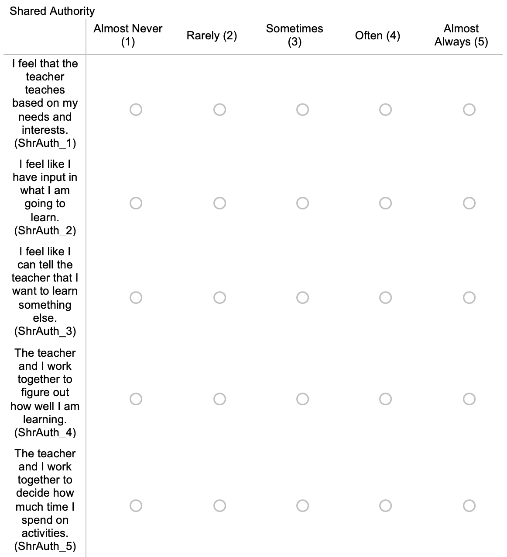
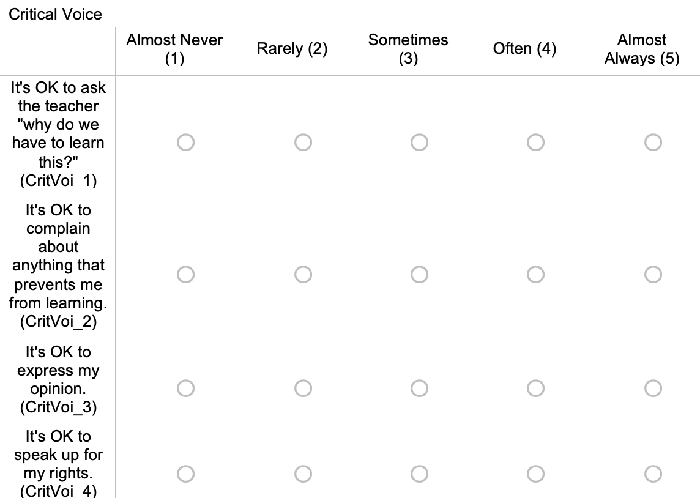
Survey Scales
Academic Year of 2017-2018 Survey responses (n =842 ) included 4 individual scales aiming to measure the DST principles (one scale), Student Engagement, Student Empowerment, and Community.
Fall of 2018 Survey responses (n = 960) included 7 individual scales aiming to measure Student Authority (a DST principle), Student-Student Voice (a DST principle), Student-Teacher Voice (a DST principle), Critical STEM Literacy (a DST principle), Emotional Engagement, Self Concept in STEM, and Community Connectedness.

Slide 3
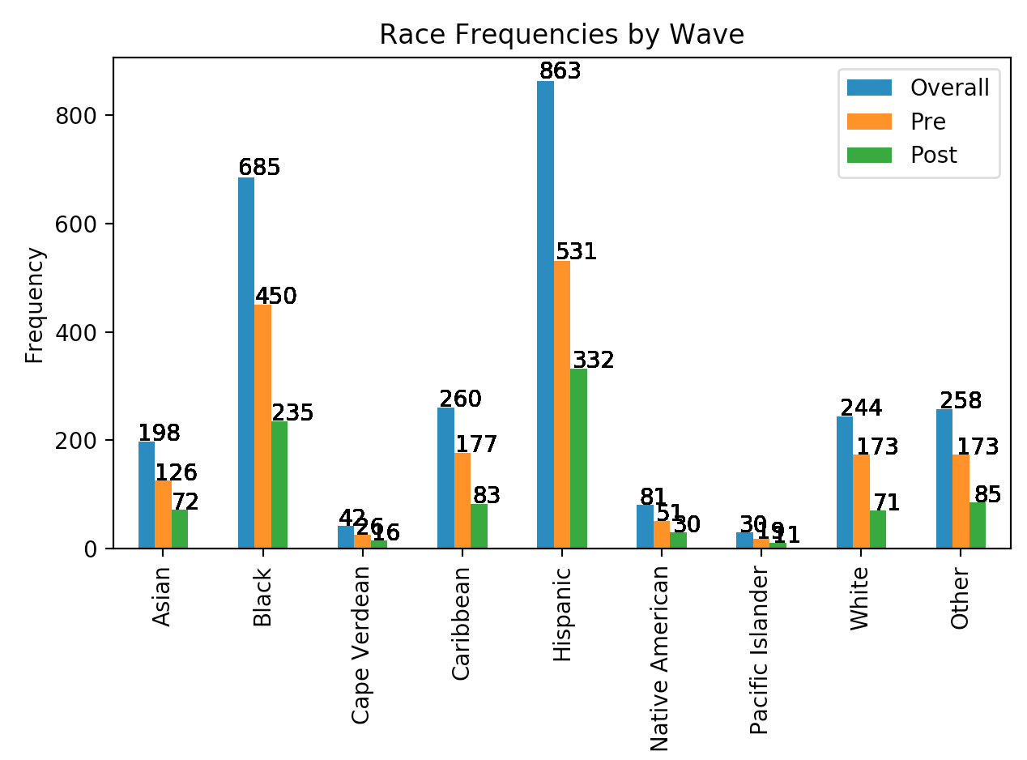
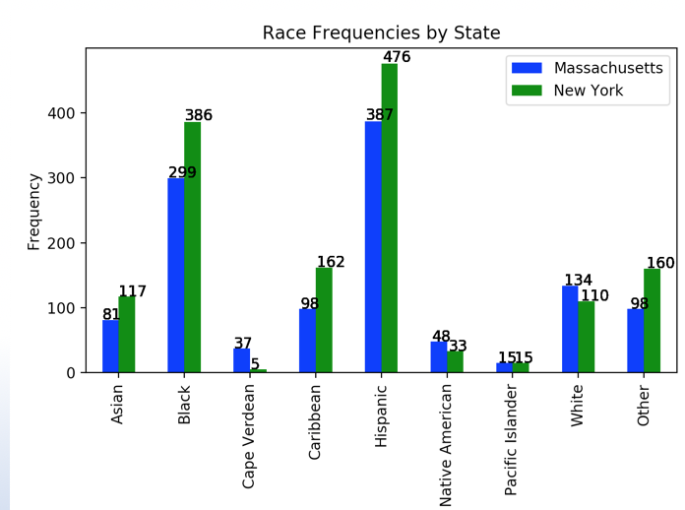
Sci Ed Demographics: Race

Slide 4
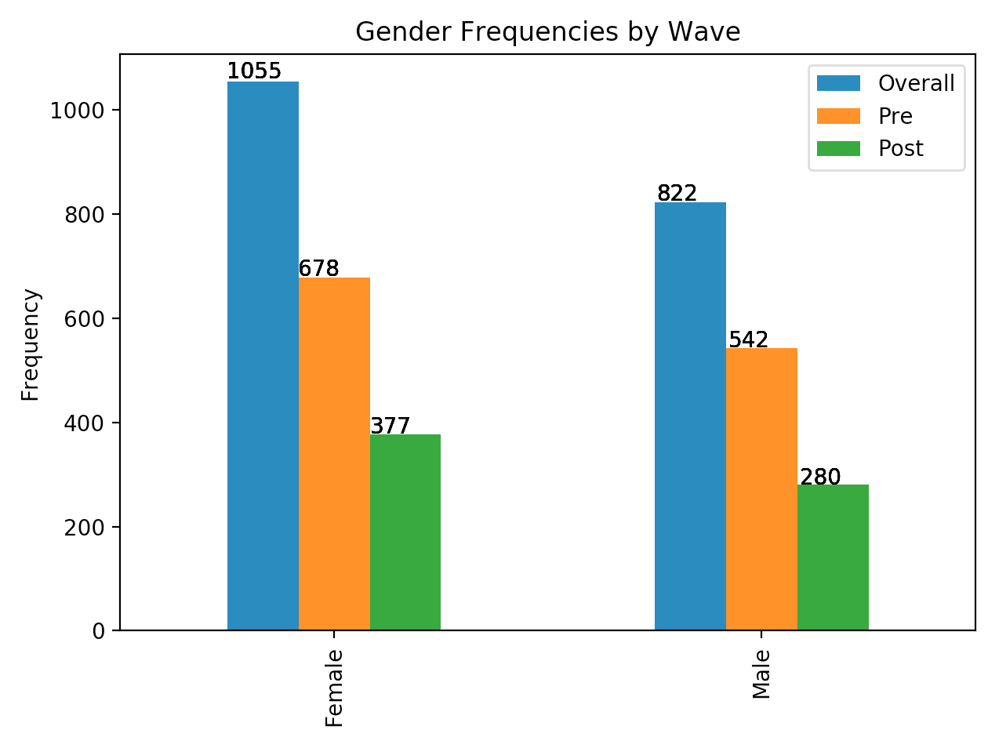
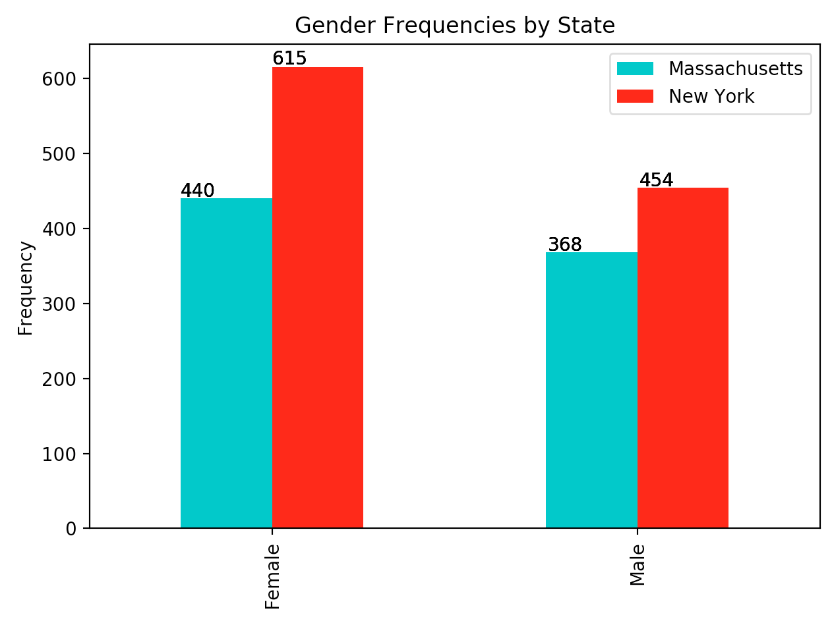
Sci Ed Demographics: Gender

Slide 5
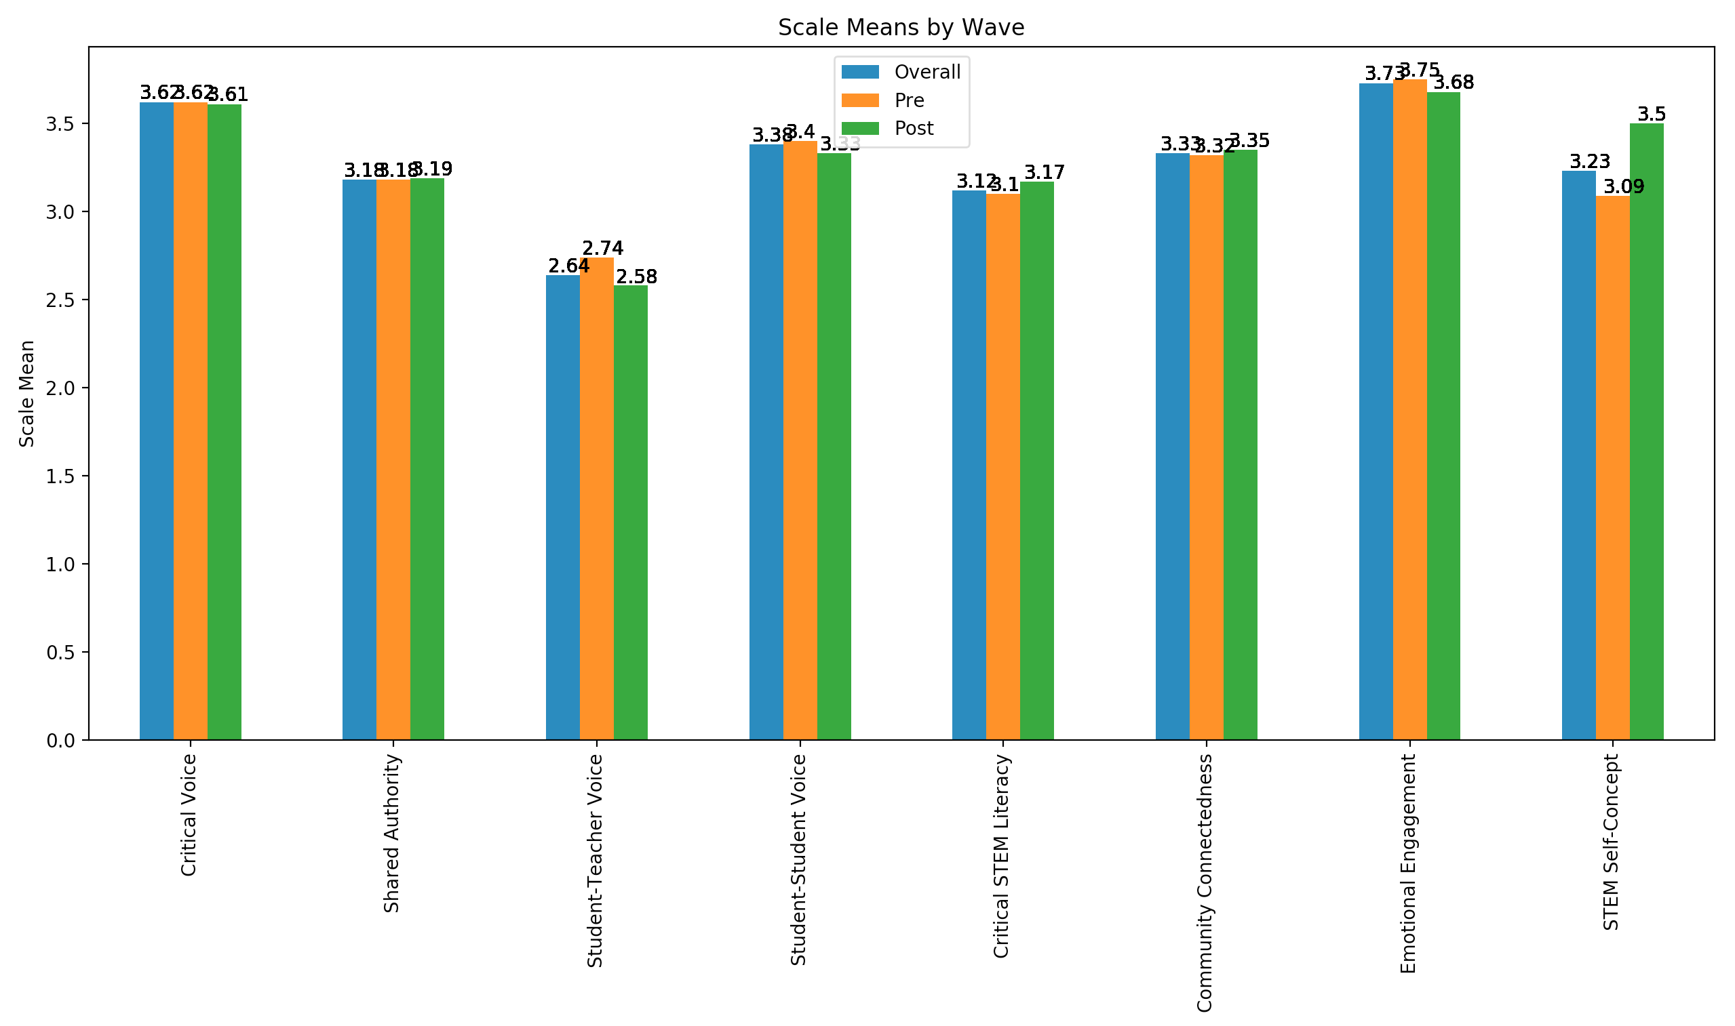
Sci Ed Scale Means by Wave

Slide 6
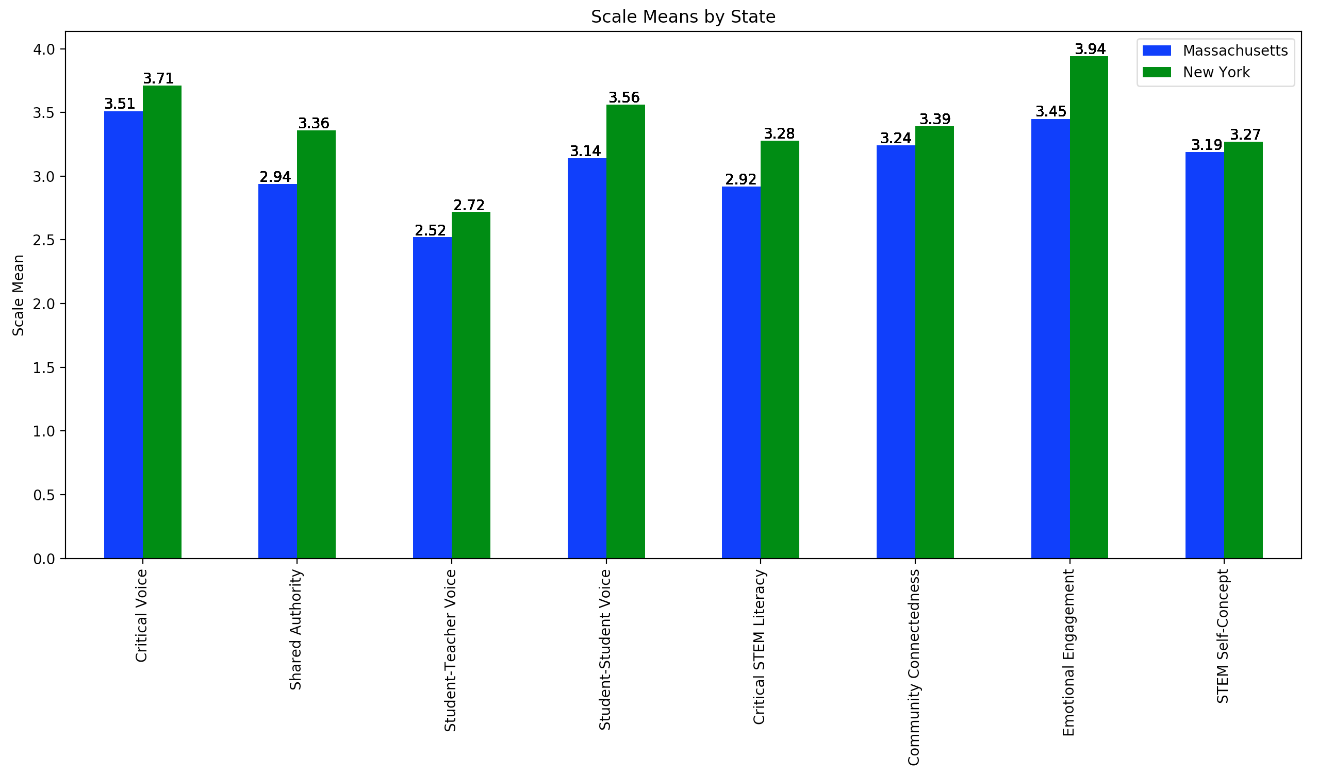
Sci Ed Scale Means by State

Slide 7
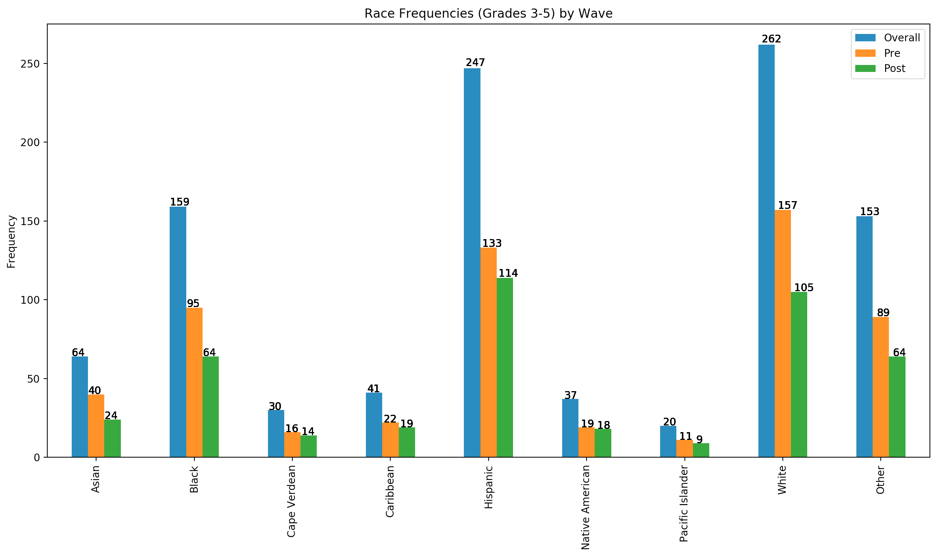
Sci Ed Grades 3-5 Demographics: Race by Wave

Slide 8
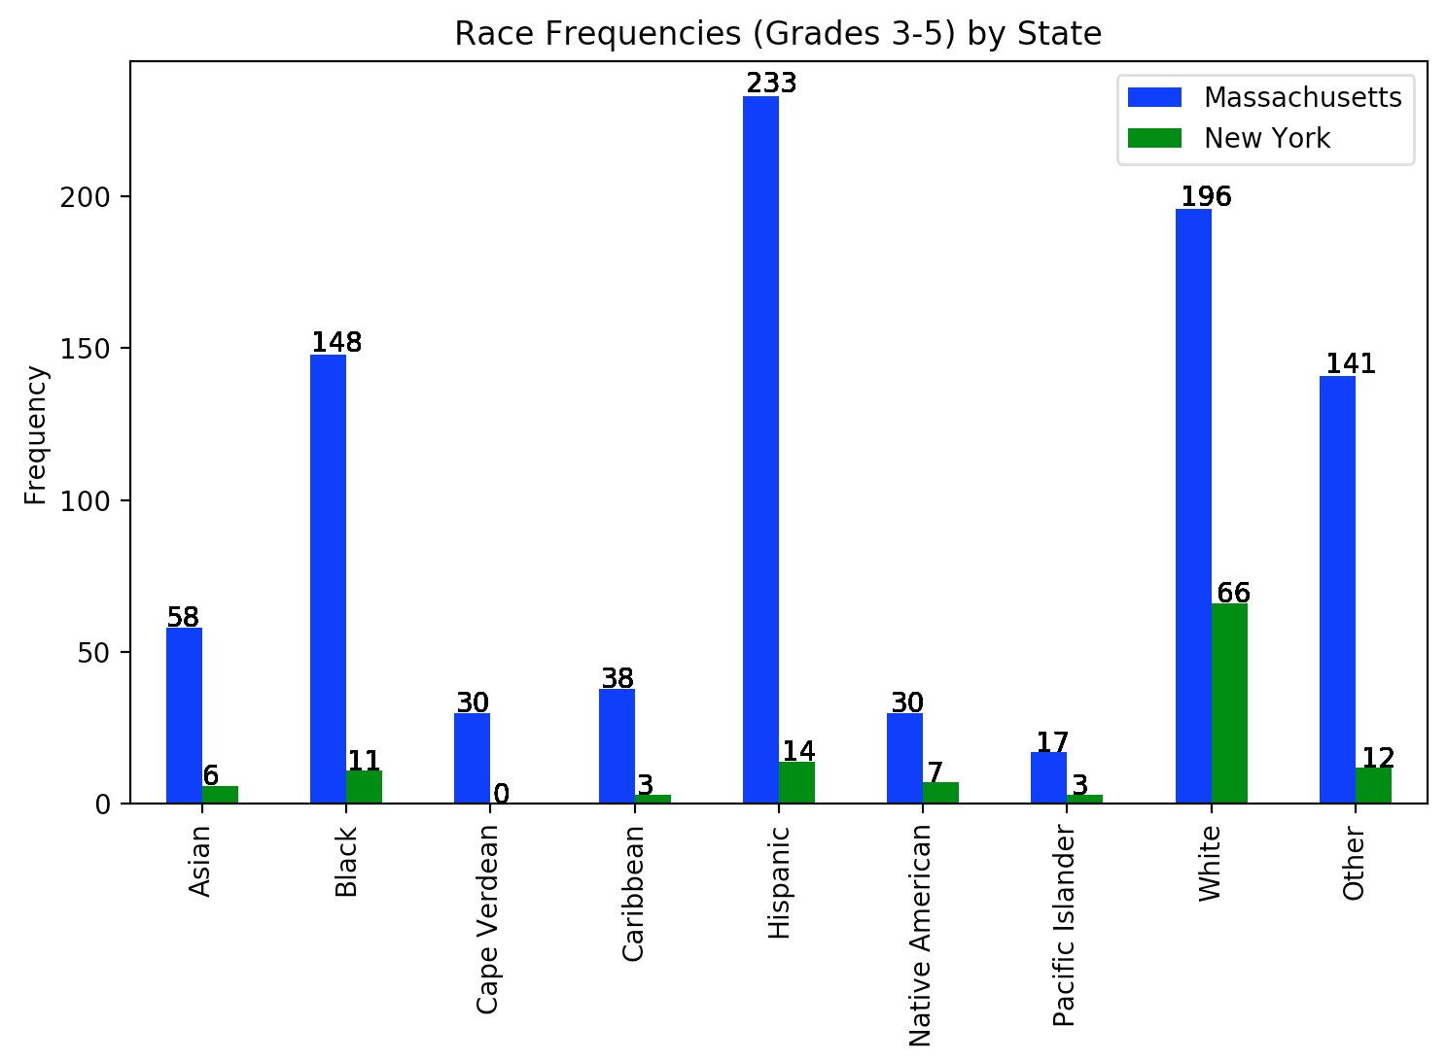
Sci Ed Grades 3-5 Demographics: Race by State

Slide 9
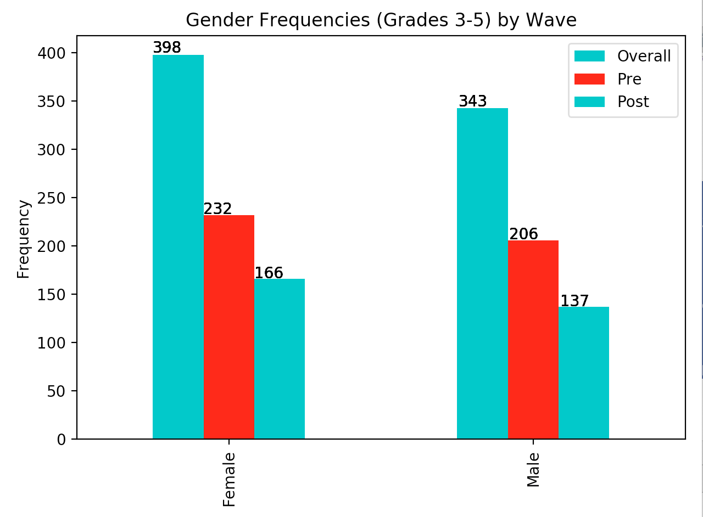
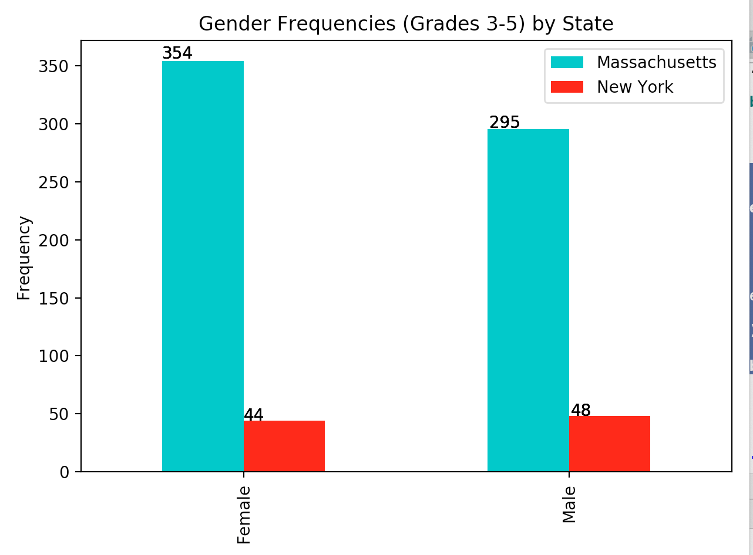
Sci Ed Grades 3-5 Demographics: Gender

Slide 10
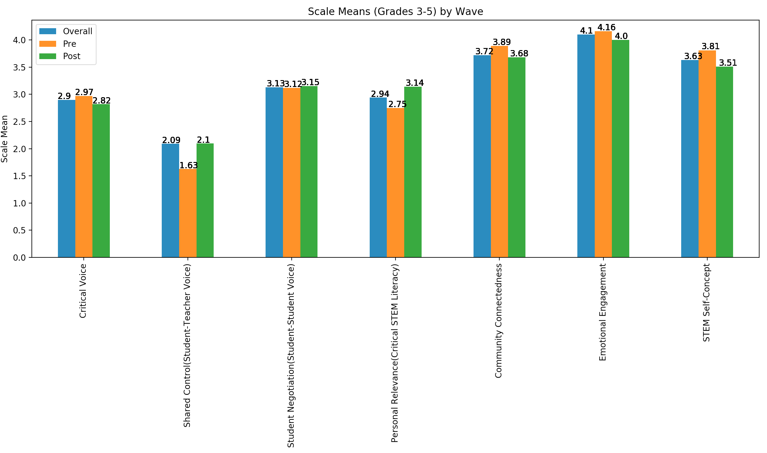
Sci Ed Grades 3-5 Scale Means by Wave

Slide 11
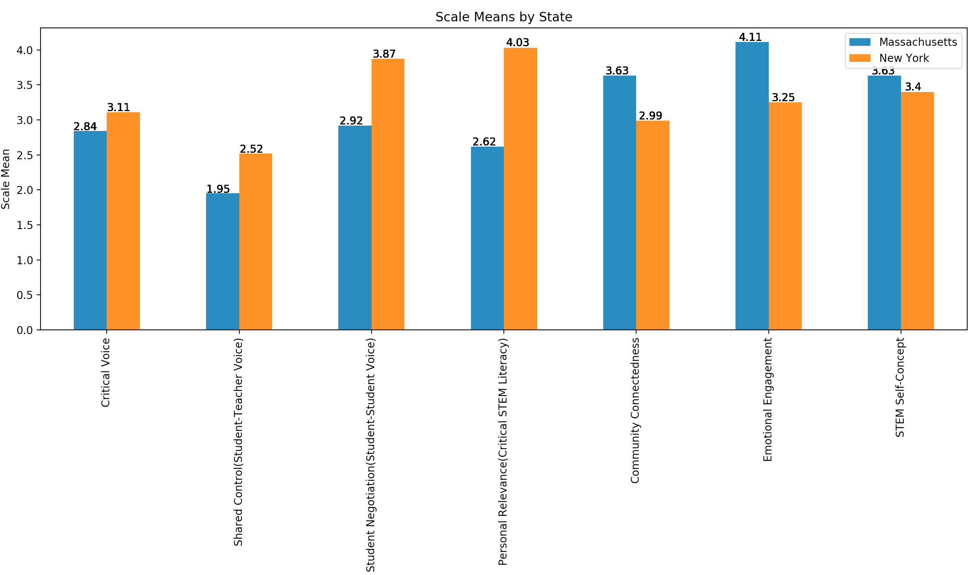
Sci Ed Grades 3-5 Scale Means by State

Slide 12
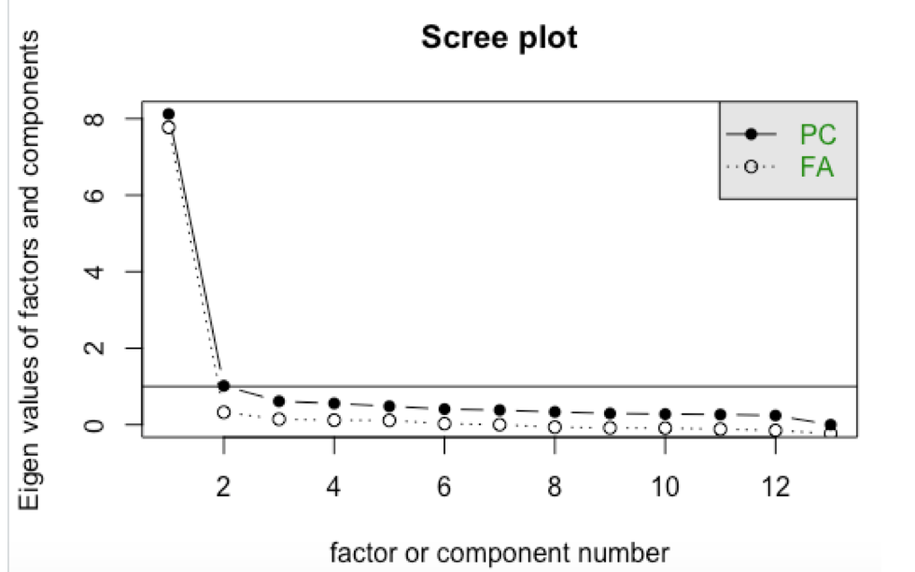

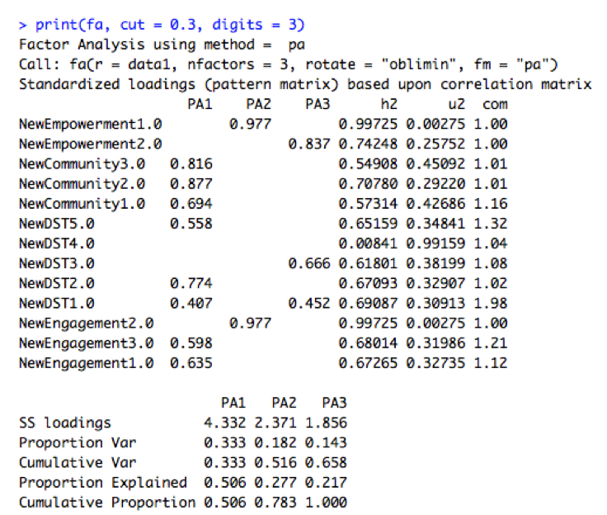
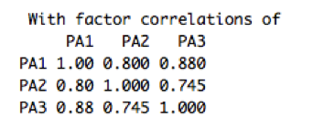
Sci-Ed Fellowship: Prior (2017) Survey Factor Analysis
With such highly correlated items (a problematic result of a ceiling effect in responses) we do not choose to interpret the one hypothetical factor.
Of the two necessary tests for the justification of this technique- only one passed.
The test that failed indicated the questions would not partition well across factors
Based on a visual plot and item loadings on factors, we initially extracted two to three factors.
But they correlated so strongly as to be suggestive of representing a single underlying factor.
We settled on one hypothetical factor from our data set of four scales.
Notes:
Bartlett’s Test was significant, suggesting items are (at least to some extent) correlated, thereby making it acceptable to undergo factor analysis.
But KMO below threshold of acceptability for factor analysis. Suggesting overly high degree of correlations between scale items (too much common variance between variables).

Slide 13
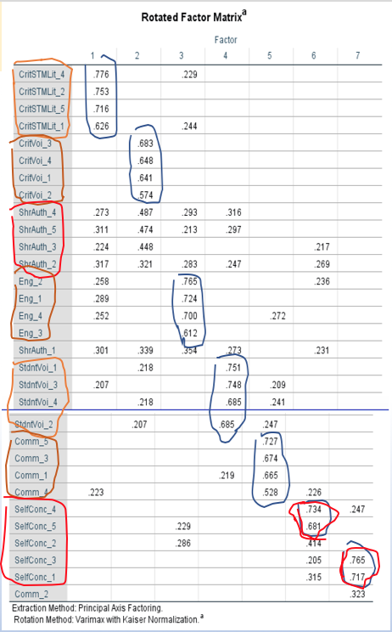
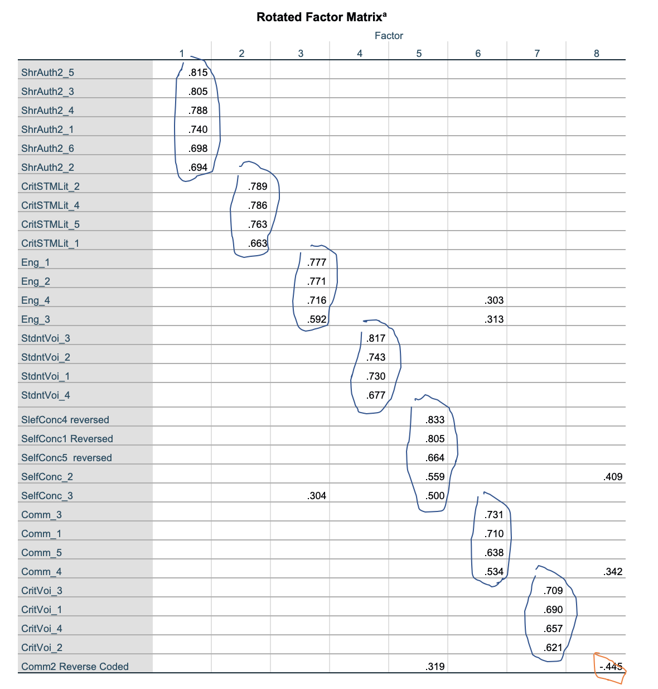
Sci-Ed: Grades 6-12 Pre vs Post Factor Analyses
Adequacy tests yielded positive
results encouraging the
subsequent use of a
factor analysis.
Pre:
evident that one factor loaded strongly for each of the following scales: Critical STEM Literacy, Critical Voice, Engagement, Student Voice, and Community.
Shared Authority scale failed to load strongly on any factor.
Math/Science Self-Concept loaded across two factors
Post:
Very clean factor analytic solution: all scales loaded strongly on one factor and weakly on other factors (factor loadings < 3.0 suppressed)
Significant Imporvement
Notes:
Adequacy tests yielded positive results encouraging the subsequent use of a factor analysis.
It was evident that one factor loaded strongly for each of the following scales: Critical STEM Literacy, Critical Voice, Engagement, Student Voice, and Community.
We note that Math/Science Self-Concept loaded across two factors, one for items 1 and 3, and another for items 4 and 5 (item 2 did not load strongly on any factor).
We note that the Shared Authority scale failed to load strongly on any factor.
We consider this a significant improvement in aligning the latent structures of our scales to a single latent trait per scale.

Slide 14
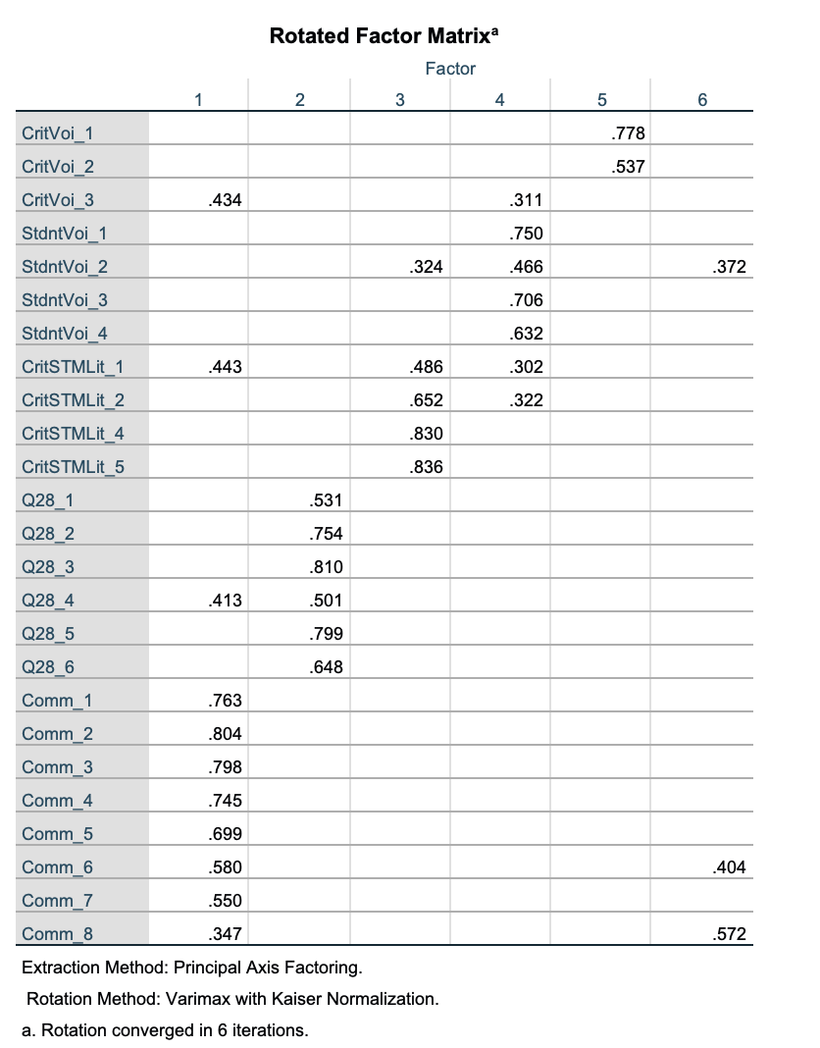
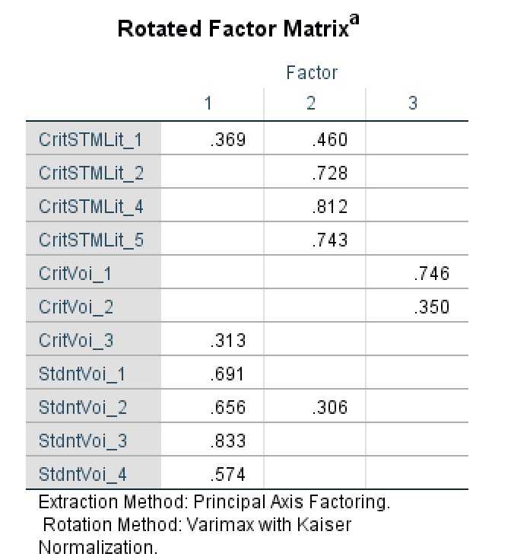
Sci-Ed: Grades 3-5 (Block A) Post Factor Analyses
Adequacy tests for Post Survey data set yielded positive results. Pre dataset inadequate for full factor analytic solution.

Slide 15
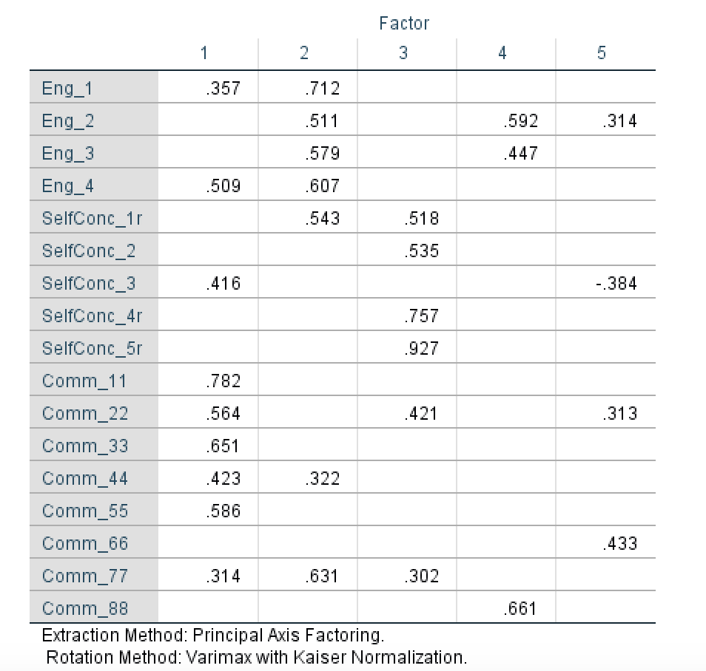
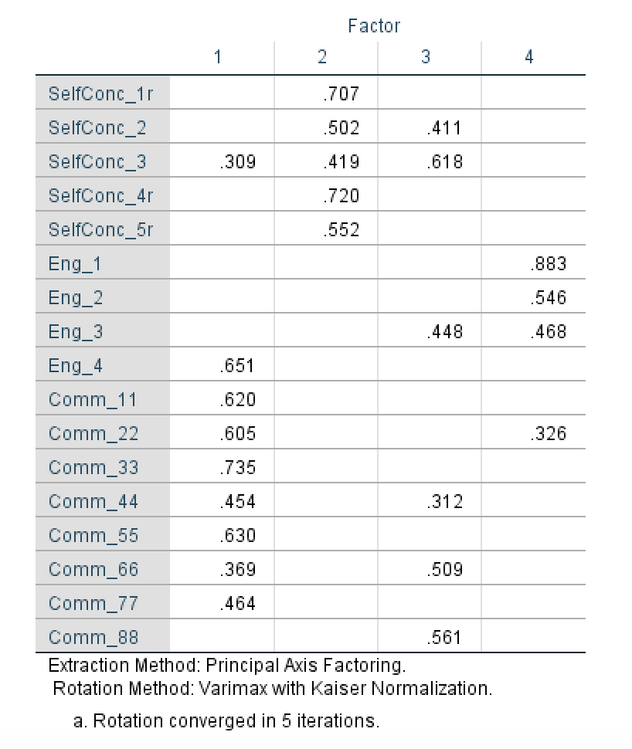
Sci-Ed: Grades 3-5 (Block B) Pre and Post Factor Analyses

Slide 16

Basu Sci-Ed Fellowship in Collaboration with iUSE Lab
Megan McKinley
mckinlmb@bc.edu
Casandra Gonzalez
gonzalow@bc.edu
Pablo Bendiksen
bendiksp@bc.edu

